Slide 1
MIS
PERSONAL, LEGAL, ETHICAL, AND ORGANIZATIONAL ISSUES OF INFORMATION SYSTEMS
CHAPTER 4
Hossein BIDGOLI

Slide 2
Chapter 4 Personal, Legal, Ethical, and Organizational Issues of Information Systems
l e a r n i n g o u t c o m e s
LO1 Describe information technologies that could be used in computer crimes.
LO2 Review privacy issues and methods for improving privacy of information.
LO3 Explain the effects of e-mail, data collection, and censorship on privacy.
LO4 Discuss ethical issues of information technology.
LO5 Describe intellectual property principles and infringement issues.

Slide 3
Chapter 4 Personal, Legal, Ethical, and Organizational Issues of Information Systems
l e a r n i n g o u t c o m e s (cont’d.)
LO6 Explain information system issues affecting organizations, including the digital divide, electronic publishing, and effects on the workplace and employees’ health.
LO7 Discuss green computing and ways that it could help improve the quality of the environment

Slide 4
Risks Associated with Information Technologies
Misuses of information technology
  Invade users’ privacy
  Commit computer crimes
Minimize or prevent by:
  Installing operating system updates regularly
  Using antivirus software
  Using e-mail security features

Slide 5
Cookies
Cookies
  Small text files with a unique ID tag
  Embedded in a Web browser
  Saved on the user’s hard drive
Can be useful or intrusive
Many users disable cookies
  By installing a cookie manager
  Or using Web browser options

Slide 6
Spyware and Adware
Spyware
  Software that secretly gathers information about users while they browse the Web
  Can be used maliciously
Install antivirus or antispyware software
Adware
  Form of spyware
  Collects information about the user to display advertisements in the Web browser

Slide 7
Phishing
Phishing
  Sending fraudulent e-mails that seem to come from legitimate sources
Direct e-mail recipients to false Web sites
  To capture private information

Slide 8
Keyloggers
Keyloggers
  Monitor and record keystrokes
  Can be software or hardware devices
  Sometimes used by companies to track employees’ use of e-mail and the Internet
  Can be used for malicious purposes
Some antivirus and antispyware programs protect against software keyloggers

Slide 9
Sniffing and Spoofing
Sniffing
  Capturing and recording network traffic
  Often used by hackers to intercept information
Spoofing
  Attempt to gain access to a network by posing as an authorized user to find sensitive information

Slide 10
Computer Crime and Fraud
Computer fraud
  Unauthorized use of computer data for personal gain
Social networking sites
  Used for committing computer crime
Examples
  Denial-of-service attacks
  Identity theft
  Software piracy
  Distributing child pornography
  E-mail spamming

Slide 11
Computer Crime and Fraud (cont’d.)
  Writing or spreading viruses, worms, Trojan programs, and other malicious code
  Stealing file
  Changing computer records
  Virus hoaxes
  Sabotage
Company insiders commit most computer crimes

Slide 12
Internet Fraud Cost $559 Million in 2009
Losses from cybercrime more than doubled in 2009
They jumped from $265 million in 2008 to $559.7 million
Most of the complaints were about e-mail scams and the non-delivery of merchandise or payments

Slide 13
Privacy Issues
Concerns about privacy in the workplace
  Employers search social networking sites
  Employee monitoring systems
Misuse and abuse of information gathered by:
  Healthcare organizations
  Financial institutions
  Legal firms
Defining privacy is difficult
  Information technologies have increased ease of access to information

Slide 14
Social Networking Sites and Privacy Issues
Stacy Snyder
  Former student at Millersville University of Pennsylvania
  Posted a photo of herself on MySpace, wearing a pirate’s hat and drinking
Millersville administrators
  Considered the image unprofessional
  Refused to grant her an education degree and teaching certificate

Slide 15
Privacy Issues (cont’d.)
Number of databases is increasing rapidly
Enforcement of federal laws has been lax
Index and link databases using Social Security numbers
  Direct marketing companies are major users of this information
U.S. government began linking large databases to find information

Slide 16
Privacy Issues (cont’d.)
Federal laws now regulate collecting and using information on people and corporations
  1970 Fair Credit Reporting Act
Acceptable use policies
Accountability
Nonrepudiation
Hardware or software controls
  Determine what personal information is provided on the Web

Slide 17
E-mail
Presents some serious privacy issues
Spamming
  Unsolicited e-mail sent for advertising purpose
  Sent in bulk by using automated mailing software
Ease of access
  People should assume that others could have access to their messages
  Any e-mails sent on company-owned computers are the property of the organization

Slide 18
Statistics for E-mail and Spam in 2009
90 trillion – number of e-mails sent on the Internet
247 billion – average number of e-mail messages per day
1.4 billion – number of e-mail users worldwide
100 million – new e-mail users from the year before
81% – percentage of e-mails that were spam
92% – peak spam levels late in the year
24% – increase in spam over previous year

Slide 19
Data Collection on the Internet
Number of people shopping online is increasing
Some customers are reluctant to make online purchases
  Concerns about hackers getting access to their credit card numbers
  Many credit card companies reimburse fraudulent charges
Other electronic payment systems are being developed

Slide 20
Data Collection on the Internet (cont’d.)
Concerned about computers’ contents being searched while they’re connected to the Internet
Information users provide on the Web
  Combined with other information and technologies to produce new information
Log files
  Generated by Web server software
  Record a user’s actions on a Web site
Data collected on the Internet must be used and interpreted with caution

Slide 21
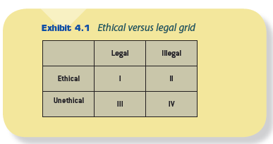
Ethical Issues of Information Technologies
Ethics and ethical decision making
  Moral guidelines people or organizations follow in dealing with others
  More difficult to determine than legal versus illegal

Slide 22
Ethical Issues of Information Technologies (cont’d.)
Information technology offers many opportunities for unethical behavior
  Cybercrime, cyberfraud, identity theft, and intellectual property theft
Many associations promote ethically responsible use of information systems and technologies
  Codes of ethics
Quick ethics test

Slide 23
Censorship
Who decides what should be on the Internet?
Types of information
  Public
  Private
Whether or not something can be censored depends in part on who is doing the censoring
Restricted access to the Internet
  Burma, China, Singapore
U.S. citizens don’t want the government controlling Internet access

Slide 24
Censorship (cont’d.)
Parents are concerned about what their children are exposed to
  Pornography, violence, and adult language
Mistaken or mistyped URLs
Search terms
Guidelines to teach their children to use good judgment while on the Internet
Programs such as CyberPatrol, CyberSitter, Net Nanny, and SafeSurf

Slide 25
Intellectual Property
Intellectual property
  Protections that involve copyrights, trademarks, trade secrets, and patents for “creations of the mind” developed by people or businesses
Industrial property
  Inventions, trademarks, logos, industrial designs
Copyrighted material
  Literary and artistic works
  May apply to online materials
  Exceptions under Fair Use Doctrine

Slide 26
Intellectual Property (cont’d.)
Trademark
  Protects product names and identifying marks
Patent
  Protects new processes
  Advantages of patents
Software piracy
Laws
  Telecommunications Act of 1996
  Communications Decency Act (CDA)
  Laws against spamming

Slide 27
Intellectual Property (cont’d.)
Internet use policy
  Guard against legal issues and avoid the risks
Cybersquatting
  Registering, selling, or using a domain name to profit from someone else’s trademark

Slide 28
Verizon’s Cybersquatting Suit
Verizon sued OnlineNic
OnlineNic registered domain names containing Verizon trademarks
  myverizonwireless.com
  iphoneverizonplans.com
  verizon-cellular. com
Verizon won this suit

Slide 29
Social Divisions and the Digital Divide
Digital divide
  Computers still aren’t affordable for many people
  Haves and have-nots
  Companies installing cables for Internet connections might subject their communities to a type of economic “red-lining”
Children are often victims of this divide
  Funding for computers at schools and libraries
  Loaner programs

Slide 30
The Impact of Information Technology in the Workplace
New jobs for:
  Programmers
  Systems analysts
  Database and network administrators
  Network engineers
  Webmasters
  Web page developers
  e-commerce specialists
  Chief information officers (CIOs)
  Technicians

Slide 31
The Impact of Information Technology in the Workplace (cont’d.)
Web designers
Java programmers
Web troubleshooters
Telecommuting and virtual work
Job deskilling
  Skilled labor eliminated by introducing high technology
  Job downgraded from a skilled to a semiskilled or unskilled position

Slide 32
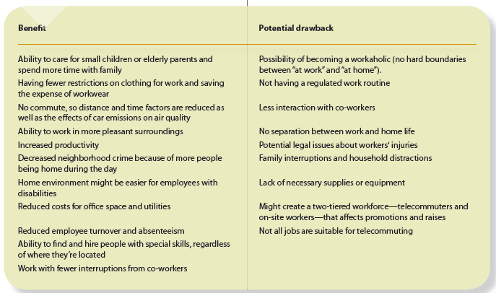
Advantages and Disadvantages of Telecommuting

Slide 33
The Impact of Information Technology in the Workplace (cont’d.)
Job upgrading
  Clerical workers who now use computers
One skilled worker might be capable of doing the job of several workers
Virtual organizations
  Networks of independent companies, suppliers, customers, and manufacturers
  Connected via information technologies
  Share skills and costs
  Have access to each other’s market

Slide 34
Information Technology and Health Issues
Reports of health-related issues caused by video display terminals (VDTs)
  No conclusive study
  Health problems associated with the environment in which computers are used

Slide 35
Information Technology and Health Issues (cont’d.)
Other reports of health problems
  Vision
  Musculoskeletal
  Skin
  Reproductive
  Stress-related
Amount of time some people spend on the Web

Slide 36
Green Computing
Green computing is computing that promotes a sustainable environment and consumes the least amount of energy
Green computing involves the design, manufacture, utilization, and disposal of computers, servers, and computing devices (such as monitors, printers, storage devices, and networking and communications equipment) in such a way that there is minimal impact on the environment

Slide 37
Ways to Pursue a Green Computing Strategy
Designing products that last longer and are modular in design so that certain parts can be upgraded without replacing the entire system
Designing search engines and other computing routines that are faster and consume less energy
Replacing several underutilized smaller servers with one large server using a virtualization technique

Slide 38
Ways to Pursue a Green Computing Strategy (cont’d.)
Using computing devices that consume less energy and are biodegradable
Allowing certain employees to work from their homes, resulting in fewer cars on the roads
Replacing actual face-to-face meetings with meetings over computer networks
Using video conferencing, electronic meeting systems, and groupware

Slide 39
Ways to Pursue a Green Computing Strategy (cont’d.)
Using a virtual world
Using cloud computing
Turning off idle PCs, recycling computer-related materials, and encouraging car-pool and non-motorized transportation for employees

Slide 40
Summary
Information technologies
  Affect privacy
  Can be used for computer crimes
  Privacy issues
  E-mail
  Censorship
Organizational issues
  Digital divide
  Workplace impacts
  Health impact
  Green computing

